Slide 1

Comparing Writing Systems with Multilingual Grapheme-to-Phoneme and Phoneme-to-Grapheme Conversion
University of the Basque Country
Language Analysis and Processing
Computational Morphology
Julen Etxaniz

Slide 2
Introduction
Compare orthographic depth of languages
Shallow (transparent) orthographies (Spanish, Basque)
One-to-one correspondence between graphemes and phonemes
Deep (opaque) orthographies (English, French)
Less direct correspondence and more irregular words
Asymmetric reading and writing difficulty (French)
Learn character-level seq2seq models (transformer)
G2P direction suggests difficulty of reading
P2G direction suggests difficulty of writing

Slide 3
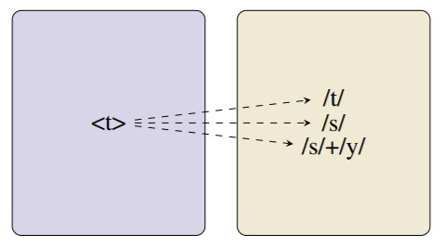
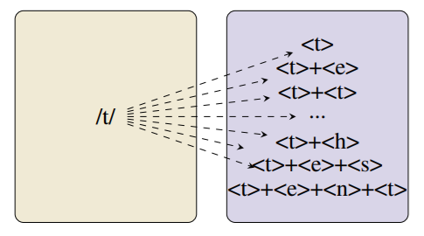
Introduction
French examples
G2P
Graphemes | Phonemes | Graphemes | Phoneme
a b l a t i f | a b l a t i f | t | t
a b o l i t i o n | a b ɔ l i s j ɔ̃ | t | s
a c q u i t t e r | a k i t e | t t | t
a u g u s t e | o ɡ y s t | t e | t
a t h l è t e | a t l ɛ t | t h | t
a c t e s | a k t | t e s | t
a s s i s t e n t | a s i s t | t e n t | t
P2G

Slide 4
Data
The SIGMORPHON 2021 G2P medium-resource data
10,000 examples of 10 languages
Split into training (80%), development (10%) and testing (10%)
Extracted from the English Wiktionary using WikiPron
Allows to compare results with baseline
Quality assurance to fix inconsistencies
Fair comparison between languages

Slide 5
Preprocessing
Tokenize graphemes and phonemes
Minimum of 5 occurrences of each token
Remaining tokens mapped to unknown
Calculate grapheme and phoneme frequencies
Compare unique and average counts
Extract some clues about results
Georgian has the same amount
French and Korean have different counts

Slide 6
Preprocessing
Language | Code | Unique G | Unique P | Average G | Average P
Armenian (Eastern) | arm_e | 38 | 41 | 7.09 | 7
Bulgarian | bul | 29 | 45 | 8.44 | 8.64
Dutch | dut | 30 | 45 | 7.71 | 6.99
French | fre | 37 | 37 | 7.52 | 5.75
Georgian | geo | 33 | 33 | 7.74 | 7.74
Serbo-Croatian (Latin) | hbs_latn | 27 | 61 | 7.47 | 7.36
Hungarian | hun | 34 | 61 | 7.65 | 7.18
Japanese (Hiragana) | jpn_hira | 76 | 64 | 4.21 | 6.56
Korean | kor | 559 | 60 | 2.58 | 6.54
Vietnamese (Hanoi) | vie_hanoi | 89 | 49 | 5.81 | 7.51
Average | average | 95.2 | 49.6 | 6.62 | 7.13

Slide 7
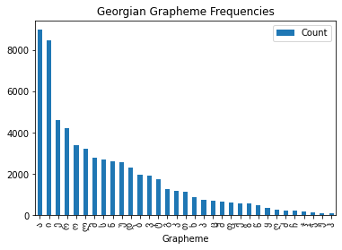
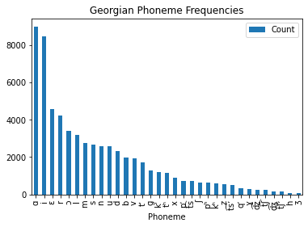
Preprocessing
Georgian: same grapheme and phoneme frequencies

Slide 8

Training
Fairseq to train small transformer model
4 encoder-decoder layers
4 self-attention heads
Embedding size is 256
Hidden size of feed-forward layer 1024
Around 7.4M parameters
Batch size 400
Learning rate 0.001
Dropout rate 0.1
Early stopping 20 epochs

Slide 9
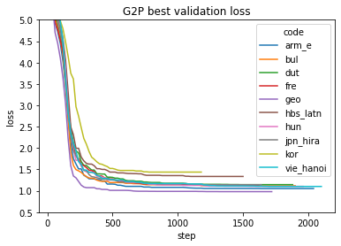
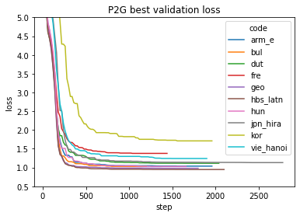
Training
Monitor using TensorBoard
Biggest improvement in the first 500 steps

Slide 10
Testing
Best checkpoint of each model
Beam search with a size of 5
Train, Dev and Test scores
Word error rate (WER) metric
Percentage of wrong word predictions

Slide 11
Results – G2P Baseline
Code | Baseline Dev | Transformer Dev | Baseline Test | Transformer Test
arm_e | 4.50 | 6.5 | 7.00 | 8.90
bul | 8.30 | 14.9 | 18.30 | 20.10
dut | 10.80 | 12.0 | 14.70 | 16.90
fre | 7.40 | 9.5 | 8.50 | 10.20
geo | 0.00 | 0.3 | 0.00 | 0.10
hbs_latn | 34.70 | 49.2 | 32.10 | 47.70
hun | 1.50 | 2.8 | 1.80 | 1.90
jpn_hira | 6.20 | 8.4 | 5.20 | 8.50
kor | 18.40 | 33.4 | 16.30 | 30.20
vie_hanoi | 1.30 | 4.0 | 2.50 | 6.00
average | 9.31 | 14.1 | 10.64 | 15.05

Slide 12
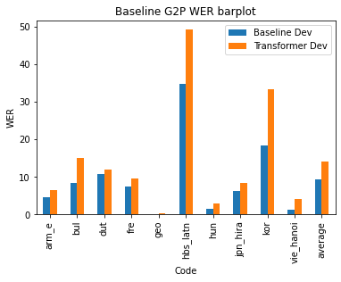
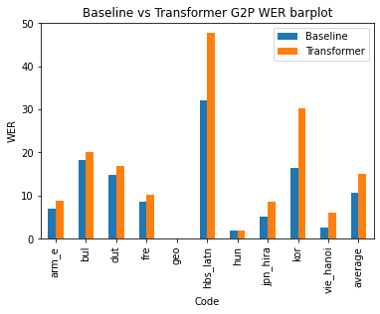
Results – G2P Baseline
Worse results, but good enough, ranks maintained

Slide 13
Results – G2P and P2G
Code | G2P Train | G2P Dev | G2P Test | P2G Train | P2G Dev | P2G Test
arm_e | 1.16 | 6.5 | 8.90 | 0.57 | 4.40 | 5.70
bul | 0.34 | 14.9 | 20.10 | 16.25 | 19.70 | 27.30
dut | 2.59 | 12.0 | 16.90 | 2.67 | 18.00 | 23.00
fre | 2.04 | 9.5 | 10.20 | 32.96 | 53.50 | 54.00
geo | 0.06 | 0.3 | 0.10 | 0.12 | 0.30 | 0.50
hbs_latn | 22.56 | 49.2 | 47.70 | 0.09 | 0.20 | 0.60
hun | 0.64 | 2.8 | 1.90 | 0.84 | 6.20 | 4.80
jpn_hira | 2.74 | 8.4 | 8.50 | 0.59 | 2.40 | 3.90
kor | 19.27 | 33.4 | 30.20 | 11.84 | 22.80 | 22.10
vie_hanoi | 0.44 | 4.0 | 6.00 | 5.35 | 15.00 | 16.30
average | 5.18 | 14.1 | 15.05 | 7.13 | 14.25 | 15.82

Slide 14
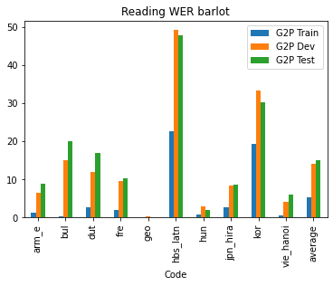
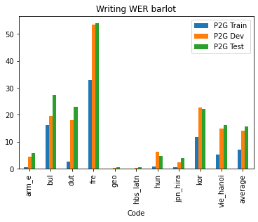
Results – G2P and P2G
Train vs Dev vs Test | G2P vs P2G | Language vs Language

Slide 15
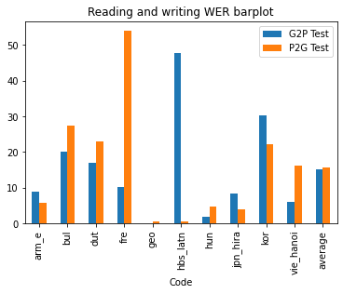
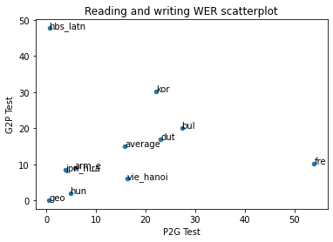
Results – G2P and P2G
Rank and group languages based on reading and writing scores

Slide 16
Conclusions
Results similar to related works
A recent work used a single model for 17 languages
Differences mainly due to inconsistencies in data
These methods are good to estimate orthographic tranparency
Fix inconsistencies to get more accurate results
Apply method to more languages
Limitations for smaller languages

Slide 17
Thank you!

